Slide 1
Titchfield Terriers
….the next tour

Slide 9
Titchfield Terriers
….the next tour

Slide 11
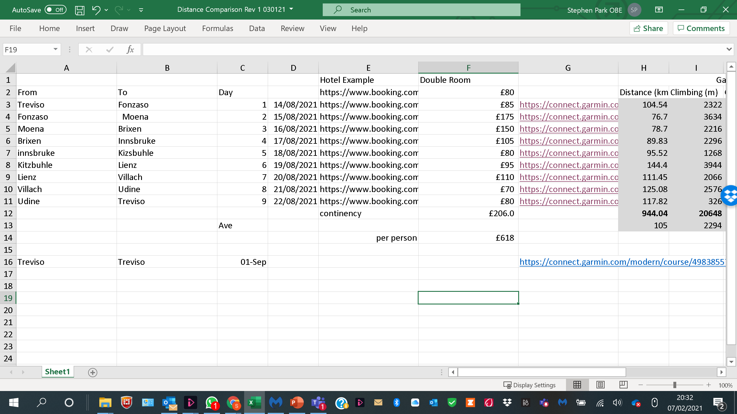

Slide 12
The Rules

